Slide 1
Mesa Airlines, Inc.
CRJ Fueling Procedures Training
Covering the full policies and procedures for into-plane fueling of the CRJ-900 aircraft.

Slide 2
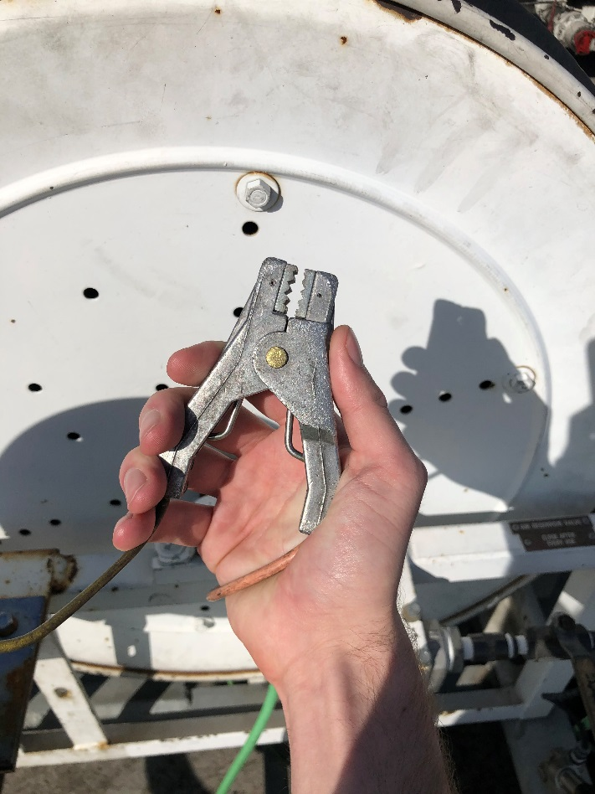
Electrostatic Bonding
Always bond an aircraft prior to starting the fueling operation to prevent an electric spark.
The fuel tender, aircraft and nozzle MUST be bonded.
Warning: A static electric spark could cause an explosion or a fire.

Slide 3
CRJ Bonding Locations
The CRJ aircraft have 5 (five) approved bonding locations:
  Nose Landing Gear Compartment Lug
  Wing Leading Edges
  Right or Left Main Landing Gear Lug
  Fuel Access Panel Grounding Lug

Slide 4
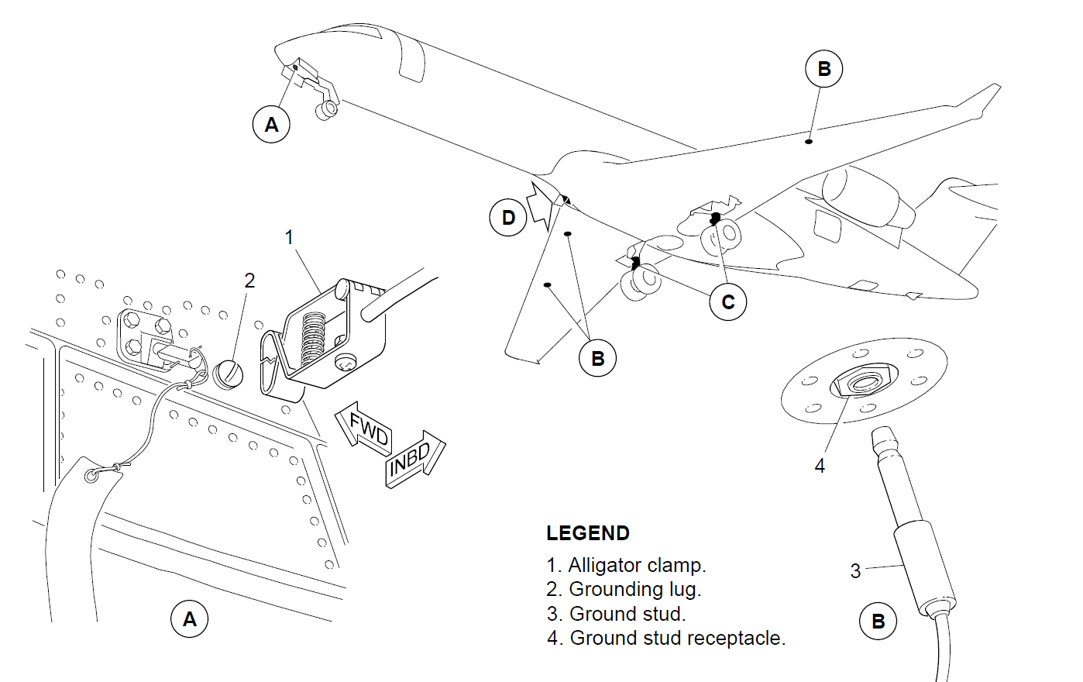
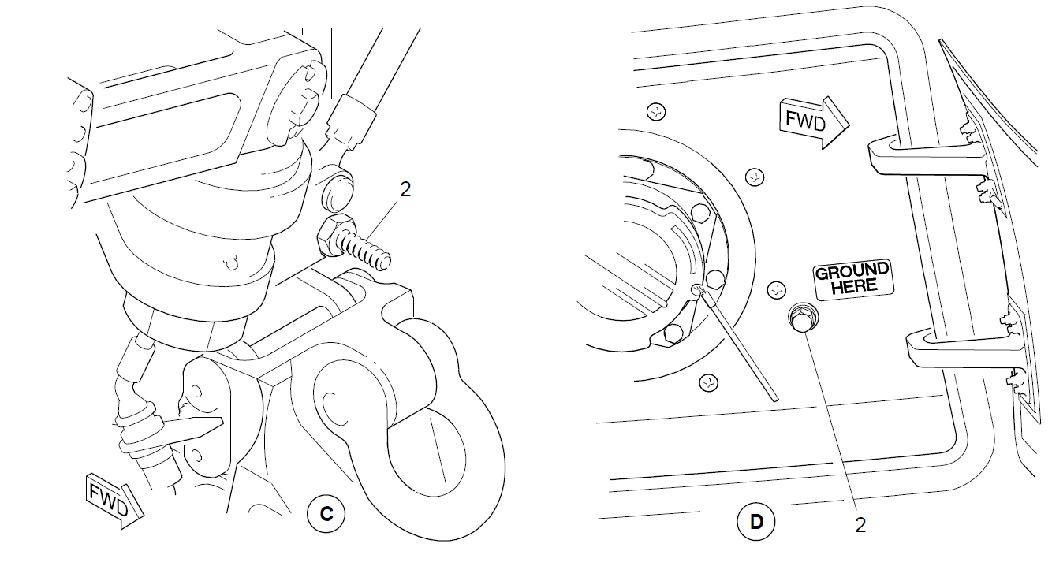
CRJ Bonding Locations
Inside the nose landing gear compartment (A), and on both the left and right main landing gear (C) are lugs/screws for a clamp type connector (1).
A clamp type connector can also be connected to the fuel panel grounding lug (D).

Slide 5
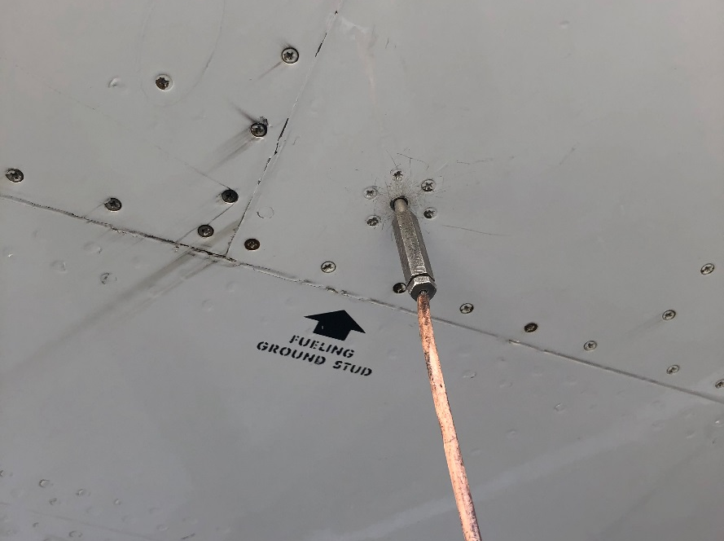
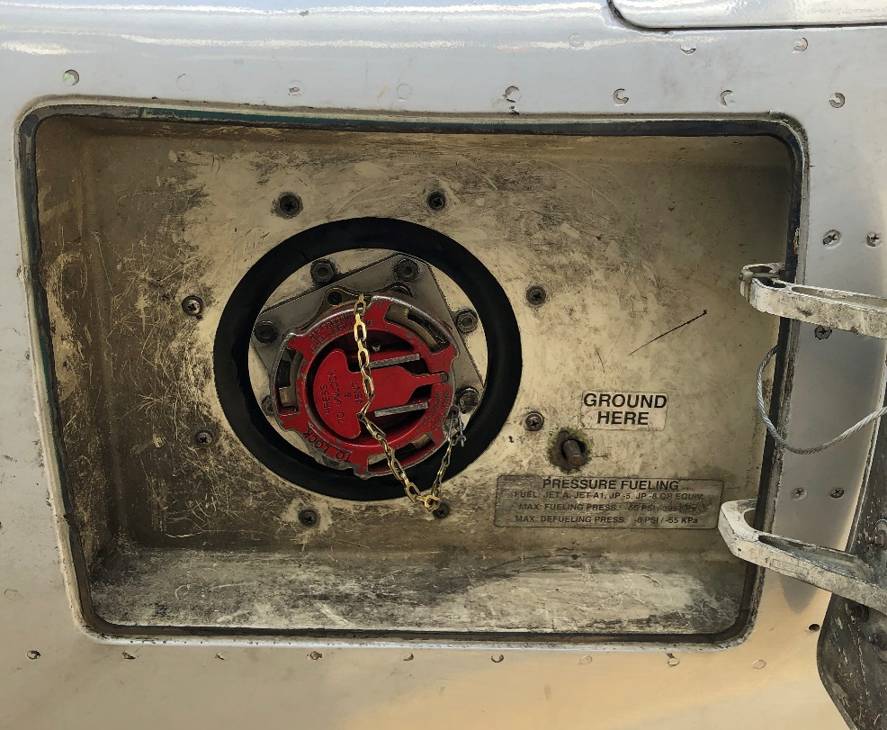
CRJ Bonding Locations
An example of the “plug” style grounding stud located on the leading edge of the wings.
The single-point fuel port panel is shown, where the fuel nozzle is connected. To the right of that is a grounding lug that a bonding clamp can be connected to in order to properly bond the aircraft and fuel tender.

Slide 6
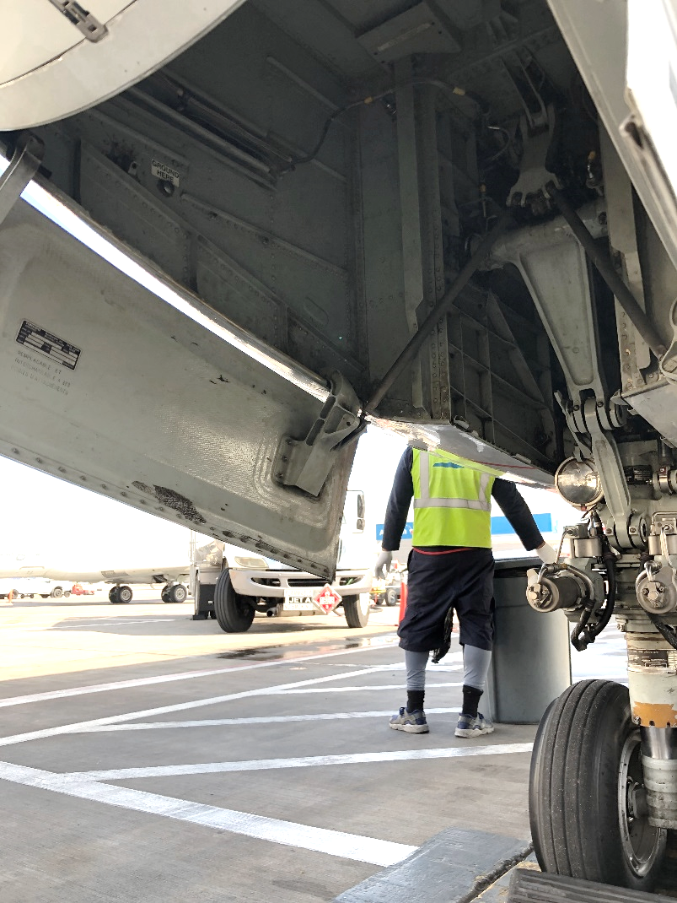
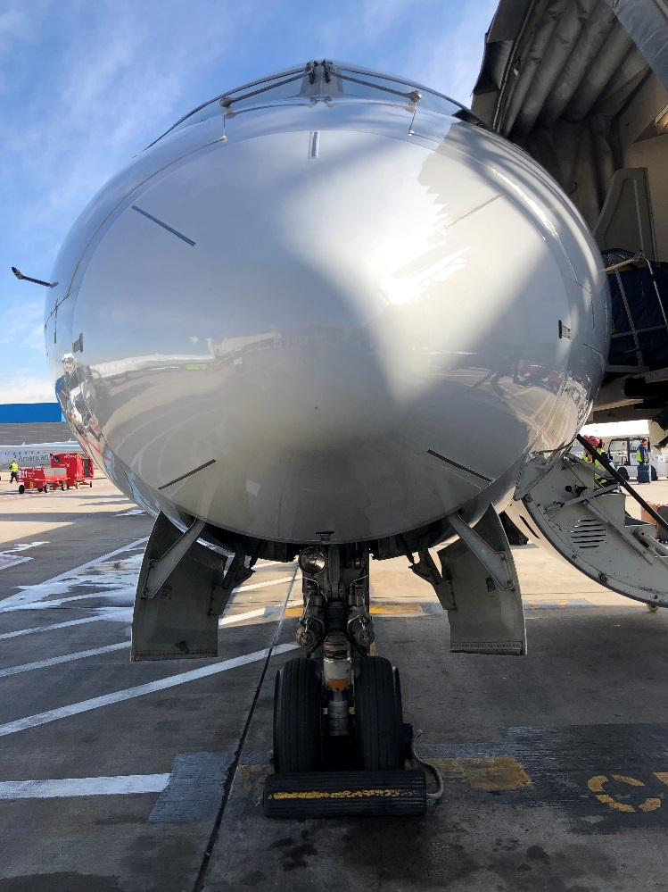
CRJ Bonding Locations
The nose landing gear door contains a grounding lug that may be used with a clamp.
It is located on the aircraft’s right side, forward of the landing gear and above the gear door, as shown here.

Slide 7
CRJ Tank Specifications
CRJ-900
Location | Usable Fuel | Unusable Fuel | Total Volume
Left Main Tank | 7435.5 lbs. (3372.7 kg) | 57 lbs. (25.9 kg) | 7492.5 lbs. (3398.5 kg)
Right Main Tank | 7435.5 lbs. (3372.7 kg) | 57 lbs. (25.9 kg) | 7492.5 lbs. (3398.5 kg)
Center Tank | 4583.3 lbs. (2079 kg) | 27 lbs. (12.2 kg) | 4610.3 lbs. (2091 kg)
Total Usable Fuel Capacity |  | 19595 lbs. (8888 kg)

Slide 8
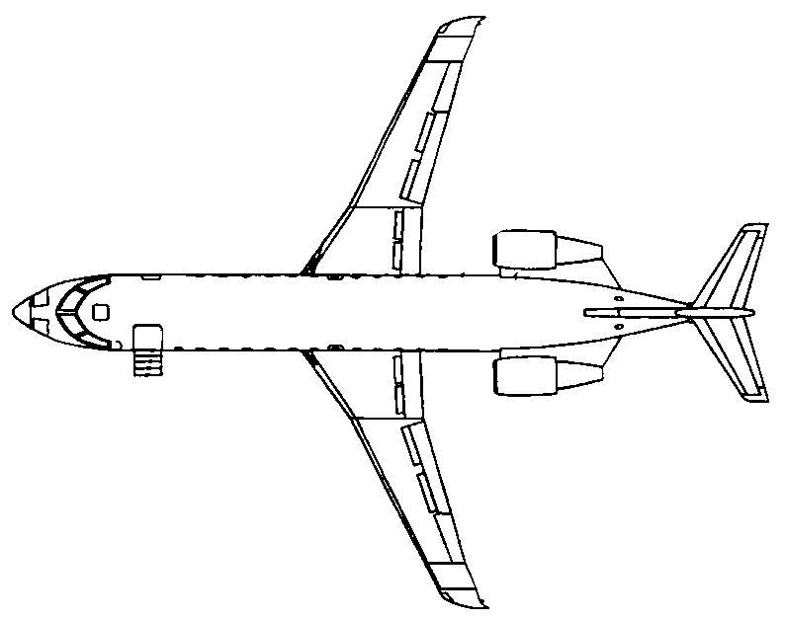
CRJ Tank Specifications
During fueling, the main tanks must never have an imbalance more than the identified limit.
Allowing fuel quantities greater than the limit specified can cause the aircraft to shift and injure people or damage equipment and the aircraft.
Right “main”
Center tank
Left “main”
Fleet Type | Maximum Allowable Fuel Tank Imbalance
CRJ-900 | 2500 lbs. (1134 kg)

Slide 9
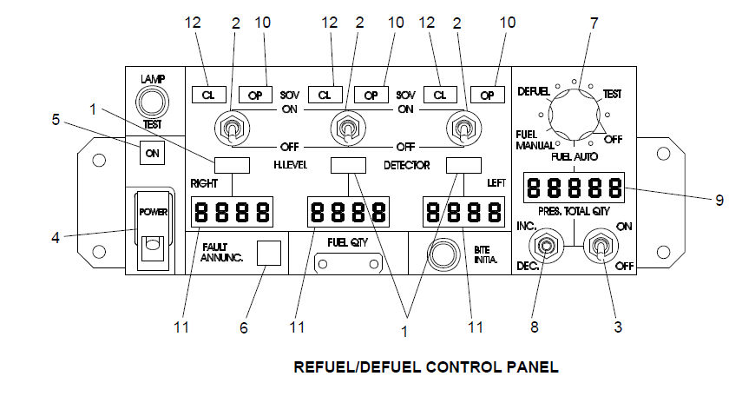
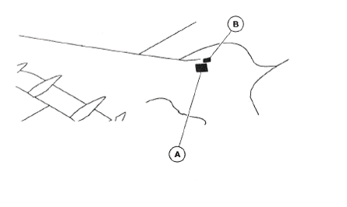
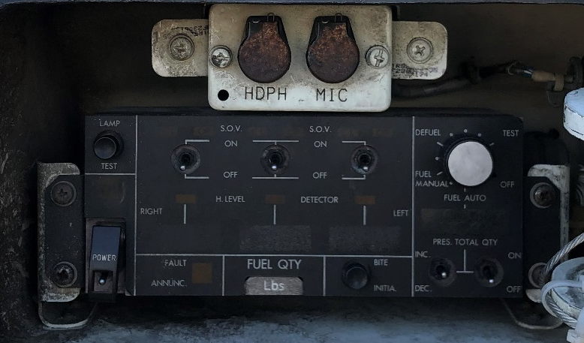
CRJ Fuel Control Panel
H. Level (Tank Full) Detector Indicator Light
Refuel SOV Toggle Switch
Auto-Start Switch
Power Toggle Switch
Power ON Indicator Light
Fault Annunciator
Mode Selector
Selector (Inc/Dec) Switch
Pre-Selected Fuel Quantity
SOV Indicator Light (OP)
Fuel-Tank Quantity Display
SOV Indicator Light (CL)

Slide 10
System Faults
If the Fault Annunc. Indicator Light (6) comes on, immediately notify the flight crew and stop fueling.
Push and hold the BITE INITIA switch/button for a minimum of 30 seconds.
Write down any codes displayed and provide them to the pilot-in-command (PIC) . The PIC may call for maintenance to troubleshoot the problem, or may direct you to perform overwing fueling.

Slide 11
Types of CRJ Fueling Operations
Single-Point Pressure Refueling
  Used when fueling in automatic or manual pressure mode. The automatic mode and single-point pressure port should be used at all times unless the system is inoperative.
Gravity Refueling (Overwing)
  Gravity refueling may be used ONLY when the single-point pressure refueling system is inoperative and care must be taken using wing-mats to prevent damage to the aircraft skin.
Suction Defueling
  If you are required to defuel a Mesa aircraft, follow the specific policies for defueling Mesa aircraft.
  Gravity defueling requires authorized Mesa maintenance personnel to be present.

Slide 12
Fueling Area Set-Up
Before configuring the fueling equipment or the airplane for fueling, the following must be confirmed:
The aircraft must be on level ground.
Ensure there are no personnel or equipment underneath the aircraft.
Ensure the aircraft is connected to ground power.
If performing overwing fueling, protective wing mats MUST be used to prevent damage or scratching of the wing surface. Mesh mats, sometimes called “bar mats” are not acceptable.

Slide 13
Fuel Operation Set-Up
Ensure the aircraft has been properly bonded.
Open the aircraft fuel access panels. Remove the fuel cap from the single-point fuel port on the aircraft and connect the fuel nozzle from the fuel tender.
Make sure the switches on the fuel control panel are set:
  The three refuel SOV switches (2) are set to OFF.
  The auto start switch (3) is set to OFF.
Pressurize the refueling hose to 45± PSI (310± kPa).
THE NOZZLE MUST NEVER BE PRESSURIZED ABOVE 50 PSI (345 kPa)

Slide 14
Fuel Operation Set-Up
Slowly open the handle on the fuel nozzle to fill the manifold.
Lift the guard off the Power toggle switch (4), and set to ON. Ensure the Power ON indicator light (5) illuminates.
NOTE: If the Fault Annunc. Indicator Light (6) comes on at any time, stop fueling and follow the procedure covered earlier in this lesson.

Slide 15
CRJ Fuel System Test
Push the BITE INITIA button for at least 30 seconds.
Look at the PRES. TOTAL QTY display (9) for codes. Record any codes and provide them to the PIC or Mesa Airlines, Inc. maintenance personnel before refueling the aircraft.
Push the LAMP TEST button in the top, left corner of the fuel control panel and ensure that all the lights on the panel come on. When released, all lights except the Power ON indicator (5) should go off.
Push and release the BITE INITIA button again. Ensure the RIGHT, CENTER and LEFT QTY displays (11) show “888”.

Slide 16
CRJ Fuel System Test
Set the mode selector (7) to “Test”.
  Ensure that the three shutoff-valve (SOV) OP indicator lights (10) come on for 5 to 20 seconds in sequence.
  Ensure that the three H. LEVEL DETECTOR indicator lights (1) also come on and go off in sequence.
  Ensure that the three SOV OP indicator lights (10) go off and the SOV CL indicator lights (12) come on.
  Ensure the Fault Annunc. Indicator Light (6) is off, or record the codes and provide this to the PIC or Mesa maintenance personnel.
  Now that our system has been tested, we may begin configuring the aircraft to fuel.

Slide 17
Automatic Refueling
Set the mode selector (7) to FUEL AUTO. Make sure that the PRES. TOTAL QTY indicator (9) comes on.
Use the INC/DEC switch (8) and set the necessary fuel quantity on the pre-selected fuel quantity display (9).
Set the auto start switch (3) to ON.
Ensure the applicable SOV OP lights (10) come on.
Monitor the fuel quantity in each tank to ensure the tank imbalance limit between the main left and right tanks is not exceeded.
When the preselected fuel quantity is reached, the refueling stops automatically.
NOTE: If filling tanks to full capacity, the H. LEVEL DETECTOR lights (1) will come on along with the SOV CL lights (12). The SOV OP lights (10) will turn off.

Slide 18
Automatic Refueling
Stop the automatic pressure refueling as follows:
10 seconds after fuel flow stops, set the refuel auto start switch (3) to OFF.
Set the mode selector (7) to OFF.
Set the Power toggle switch (4) to OFF.
Make sure that the Power ON light (5) goes off.
Close the guard over the Power toggle switch (4).
Disconnect the fuel tender from the aircraft as follows:
Set the nozzle pressure to 0 PSI (0 kPa). Disconnect the fuel nozzle from the single-point fuel port and reinstall the fuel cap.
Disconnect the grounding point from the aircraft and remove all tools and supplies before leaving the area.
Ensure both panels are securely latched shut for the fuel control panel and the single-point port access panel.

Slide 19
Manual Refueling
If the automatic mode is unavailable for use, manual pressure refueling should be used.
All set-up procedures and safety precautions to prepare for automatic refueling must be followed for manual refueling. This includes testing the system to ensure no faults are detected.
When fueling in manual mode, add fuel to the left and right main tanks until they reach their desired quantity. Then fill the center tank with the remaining fuel quantity.
Never fill the center tank unless both main tanks have at least 4400 lbs. (1995.80 kg) of fuel in each tank.

Slide 20
Manual Refueling
After the aircraft has been bonded, the fuel nozzle connected and pressurized, and the CRJ fuel system tested for functionality:
Set the mode selector (7) to FUEL MANUAL.
Make sure the auto start switch (3) is set to OFF.
Set the applicable refuel SOV toggle switches (2) to ON.
Make sure the applicable SOV OP lights (10) come on.
Monitor the right, center and left fuel tank quantity displays (11) until the necessary quantity is reached. Move the applicable SOV toggle switches (2) to OFF to stop fueling the respective tank.
If any H.LEVEL DETECTOR lights come on, stop fueling that tank.
WHEN FUELING, CONTINOUSLY MONITOR THE TANK QUANTITIES TO ENSURE THE MAXIMUM TANK IMBALANCE IS NOT EXCEEDED ON THE MAIN TANKS.

Slide 21
Manual Refueling
Stop the manual pressure refueling as follows:
Set all refuel SOV toggle switches (2) to OFF.
Set the mode selector (7) to OFF.
Set the Power toggle switch (4) to OFF.
Make sure that the Power ON light (5) goes off.
Close the guard over the Power toggle switch (4).
Disconnect the fuel tender from the aircraft as follows:
Set the nozzle pressure to 0 PSI (0 kPa). Disconnect the fuel nozzle from the single-point fuel port and reinstall the fuel cap.
Disconnect the grounding point from the aircraft and remove all tools and supplies before leaving the area.
Ensure both panels are securely latched shut for the fuel control panel and the single-point port access.

Slide 22
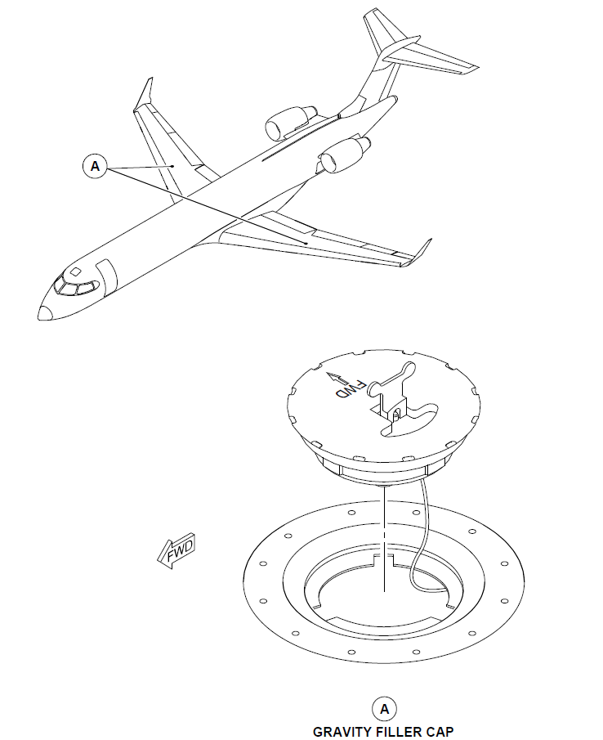
Gravity Refueling (Overwing)
If the single-point fuel port is inoperative and the PIC indicates gravity (overwing) fueling is required, the following precautions must be taken:
Solid protective wing mats MUST be utilized; mesh or “bar” mats are not permissible.
  Wing mats protect the wing’s surface from accidental damage from the fueling equipment.
There are gravity ports on the top of each wing. Make sure these are securely shut at the end of fueling and that the anchor is not broken.

Slide 23
Gravity Refueling
First, ensure the aircraft is bonded via an approved bonding method and that power is being supplied to the aircraft.
Set the Power switch (4) to ON on the fuel control panel. Skip this step if the fuel control panel is inoperative.
  If the fuel control panel is inoperative, monitor the fuel quantity supplied to the aircraft via other monitoring means.
  Use caution not to overfill the fuel tanks.
Remove the gravity fuel filler cap from the applicable tank and ensure a proper bond between the nozzle and aircraft.
Put the fuel nozzle into the fuel tank and begin dispensing fuel.
WARNING: MAKE SURE THAT THE FUEL NOZZLE DOES NOT TOUCH THE BOTTOM OF THE FUEL TANK. THE FUEL NOZZLE CAN BREAK THE PROTECTIVE COATING. DAMAGE TO THE PROTECTIVE COATING CAN CAUSE CORROSION.

Slide 24
Gravity Refueling
If the fuel control panel on the right wing is inoperative and unable to show tank quantities, an additional fueler must monitor the fuel tank quantities on the Engine Indication and Crew Alerting System (EICAS) located in the cockpit.
Stop fueling when the desired quantities are reached.
The tanks may be fueled one at a time, provided the maximum tank imbalance is not exceeded. Fueling each tank at the same time utilizing two fuelers is also permitted.
WHEN FUELING, CONTINOUSLY MONITOR THE TANK QUANTITIES TO ENSURE THE MAXIMUM TANK IMBALANCE IS NOT EXCEEDED ON THE MAIN TANKS.

Slide 25
Gravity Refueling
Stop the gravity refueling as follows:
Stop the fuel flow and remove the nozzle from the fuel port.
Install the gravity fuel filler cap. Ensure the cap anchor is not caught or broken.
Set the Power toggle switch (4) to OFF. Make sure that the Power ON light (5) goes off and close the guard.
Disconnect the grounding point from the aircraft and remove all tools and supplies before leaving the area.
Ensure panels are securely latched shut.

Slide 26
Suction Defueling
When defueling, observe all safety precautions required for fueling Mesa aircraft.
The aircraft must be connected to ground power.
  If no ground power is available, aircraft batteries may be used.
Ensure the aircraft and fuel tender are properly bonded.
Remove the cap from the refuel/defuel single-point port and connect the nozzle.

Slide 27
Suction Defueling
Ensure the aircraft has been properly bonded.
Open the aircraft fuel access panels. Remove the fuel cap from the single-point fuel port on the aircraft and connect the fuel nozzle.
Make sure the switches on the fuel control panel are set:
  The three refuel SOV switches (2) are set to OFF.
  The auto start switch (3) is set to OFF.
Pressurize the refueling hose to -8 PSI (-55 kPa).

Slide 28
Suction Defueling
Slowly open the handle on the fuel nozzle.
Lift the guard off the POWER toggle switch (4) and set to ON. Ensure the Power ON indicator light (5) illuminates.
Perform a satisfactory test of the fuel system.
Set the mode selector switch (7) to DEFUEL.

Slide 29
Suction Defueling
Set the applicable refuel SOV switches (2) to ON.
Make sure that the applicable SOV OP lights (10) come on and the applicable SOV CL lights (12) are off.
NOTE: Defuel the center tank first.
WHEN DEFUELING, CONTINOUSLY MONITOR THE TANK QUANTITIES TO ENSURE THE MAXIMUM TANK IMBALANCE IS NOT EXCEEDED ON THE MAIN TANKS.

Slide 30
Suction Defueling
If defueling to a specific quantity:
If defueling until tanks are empty:
Set the refuel SOV switches (2) to OFF when the respective desired tank quantity is reached.
Set the mode selector (7) to OFF.
The SOV CL indicator lights (12) will come on when tanks are empty. Move the applicable SOV switches (2) to OFF when the respective SOC CL indicator light (12) comes on.
Set the mode selector (7) to OFF.

Slide 31
Suction Defueling
Set the Power toggle switch (4) to OFF.
Make sure that the Power ON light (5) goes off.
Close the guard over the Power switch (4).
Disconnect the fuel tender from the aircraft as follows:
Set the nozzle pressure to 0 PSI (0 kPa). Disconnect the nozzle from the single-point fuel port and reinstall the fuel cap.
Disconnect the grounding point from the aircraft and remove all tools and supplies before leaving the area.
Ensure both panels are securely latched shut for the fuel control panel and the single-point port access.

Slide 32
This concludes the Mesa Airlines, Inc. CRJ 900 Fueling Procedures Training.
Please continue to the test to finish this course. You must pass with a score of 75% or better. Print and keep your certificate on file at your station.
If you do not pass, send an email with your name, username and station to:
Fuel@mesa-air.com

